Slide 1
Sixth Schedule

Slide 2
Sixth Schedule of the Indian Constitution
Autonomous District Councils & Tribal Self-Governance
  Constitutional Law
  Indian Federalism
  Tribal Autonomy

Slide 3
Background
Why Sixth Schedule?
  Special protection for tribal areas in Northeast India
  Historical isolation during colonial rule
  Concern over exploitation of tribal land and culture
Constitutional Basis
  Articles 244(2) and 275(1)
  Part X of the Constitution

Slide 4
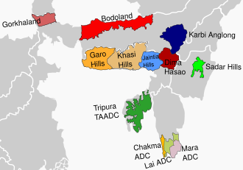
Areas Covered Under Sixth Schedule
The Sixth Schedule applies to:
  Assam
  Meghalaya
  Tripura
  Mizoram

Slide 5
What is an Autonomous District Council (ADC)?
Definition:
  A constitutional body with legislative, executive, and judicial powers in specified areas.
Structure:
  30 members
    26 elected
    4 nominated by Governor

Slide 6
Legislative Powers of ADCs
ADCs can make laws on:
  Land use and land transfer
  Forest management (excluding reserved forests)
  Shifting cultivation
  Village administration
  Inheritance of property
  Marriage and social customs
Example:
  Khasi Hills ADC regulating traditional land in Meghalaya.

Slide 7
Judicial Powers
Establish village courts
Trial of certain civil and criminal cases
Based on customary law
Example:
  Garo Hills ADC village courts applying tribal customary practices.

Slide 8
Financial Powers
ADCs can:
  Levy taxes on land
  Collect tolls
  Tax on markets
  Receive grants-in-aid from Union Government
Example:
  Bodoland Territorial Council receives central funds.

Slide 9
Major Autonomous Councils
In Assam:
  Karbi Anglong Autonomous Council
  Dima Hasao Autonomous Council
  Bodoland Territorial Council
In Meghalaya:
  Khasi Hills ADC
  Jaintia Hills ADC
  Garo Hills ADC
In Tripura:
  Tripura Tribal Areas Autonomous District Council (TTAADC)
In Mizoram:
  Chakma ADC
  Lai ADC
  Mara ADC

Slide 10
Diagram – Power Distribution
Feature | State Government | ADC
Police | Yes | No
Land Laws | Limited | Yes
Customary Law | No | Yes
Tax Collection | Yes | Yes (limited)
Judiciary | Regular Courts | Village Courts

Slide 11
Difference Between Fifth & Sixth Schedule
Fifth Schedule | Sixth Schedule
Central India | Northeast India
Governor has more control | ADCs have more autonomy
No legislative councils | Legislative & judicial powers

Slide 12
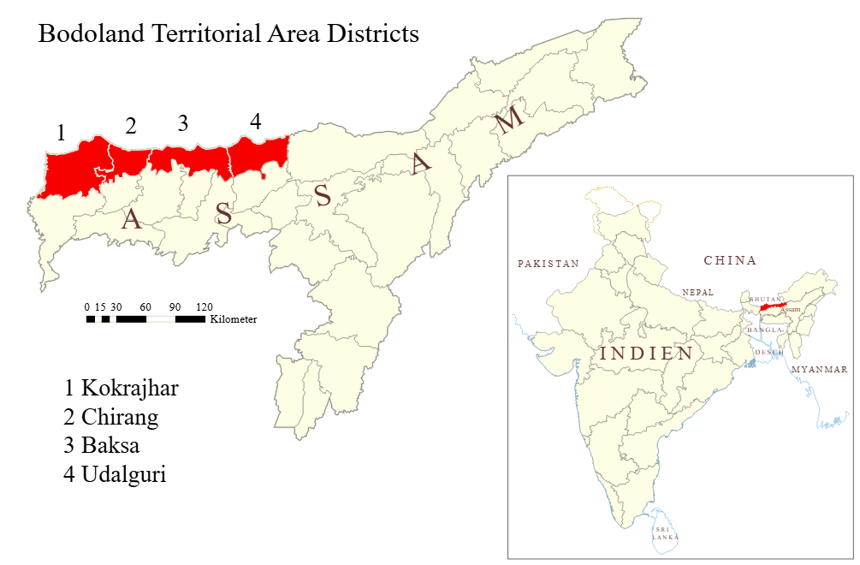
Example – Bodoland Territorial Council
Created after Bodo Accord (2003)
40-member council
Significant autonomy within Assam
Explain:
  Example of negotiated federalism
  Identity-based autonomy

Slide 13
Importance of Sixth Schedule
Protects tribal identity
Prevents land alienation
Encourages decentralization
Maintains peace through accommodation
Criticism
  Overlapping jurisdiction conflicts
  Corruption & elite capture
  Demand for separate statehood continues
  Exclusion of non-tribal minorities
Example:
  Karbi Anglong autonomy movement
  Inter-ethnic tensions in BTC areas

Slide 14
Sixth Schedule & Identity Politics
Link with your earlier lecture on:
  Naga nationalism
  Ethno-federalism
  Sub-nationalism
Concept:
  Sixth Schedule is India’s model of asymmetrical federalism.
Recent Developments
  2020 Bodo Accord
  Expansion of Bodoland Territorial Region
  Demand for inclusion of more areas under Sixth Schedule

Slide 15
Theoretical Analysis
Asymmetrical Federalism
  Different states enjoy different powers
Multicultural Constitutionalism
  Protection of minority identities
Consociational Democracy
  Power-sharing model
Conclusion
Sixth Schedule is:
  ✔ A constitutional experiment
  ✔ A conflict management tool
  ✔ A recognition of diversity
But:
⚠ It is not a permanent solution to ethnic conflicts.

Slide 16
Re-organisation of Northeast India

Slide 17
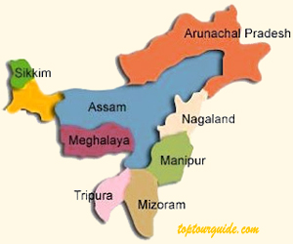
Introduction
Northeast India consists of eight states.
Often called the Seven Sisters (Assam, Arunachal Pradesh, Nagaland, Manipur, Mizoram, Tripura, Meghalaya) plus Sikkim.
The region is characterized by:
  Ethnic diversity
  Linguistic diversity
  Tribal communities
  Strategic international borders
📍 Borders with: China, Bhutan, Myanmar, Bangladesh and Nepal.

Slide 18
Post-Independence Situation
After Indian Independence
  Most of Northeast India was part of Assam.
  Several tribal communities demanded:
    Political autonomy
    Cultural recognition
    Separate statehood.
Main causes of reorganisation:
  Ethnic identity movements
  Administrative convenience
  Political demands for autonomy

Slide 19
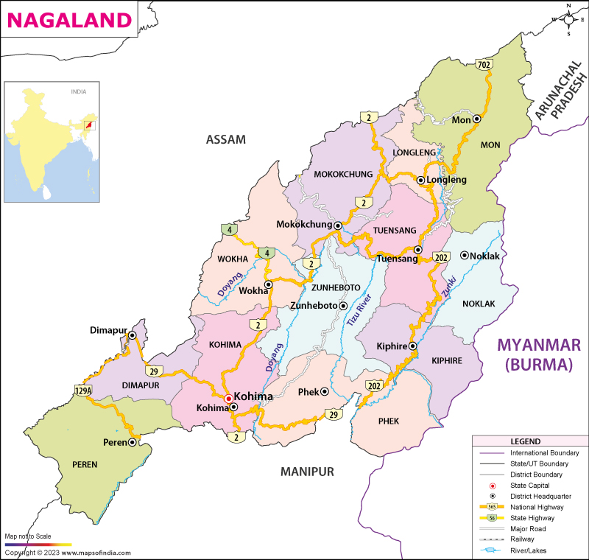
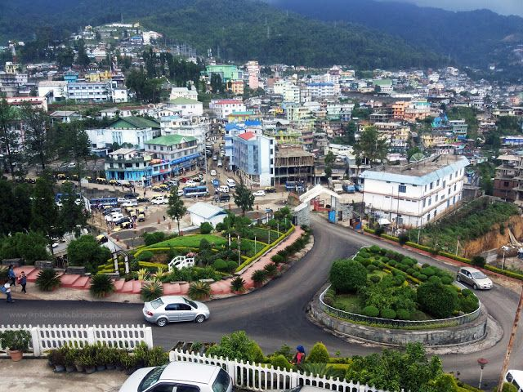
Creation of Nagaland (1963)
  Strong Naga nationalist movement.
  Led by leaders such as A. Z. Phizo.
  Demand for self-determination.
Outcome:
  Nagaland became a separate state in 1963.
Special constitutional provision:
  Article 371A
This protects:
  Naga customary law
  Religious practices
  Land ownership.

Slide 20
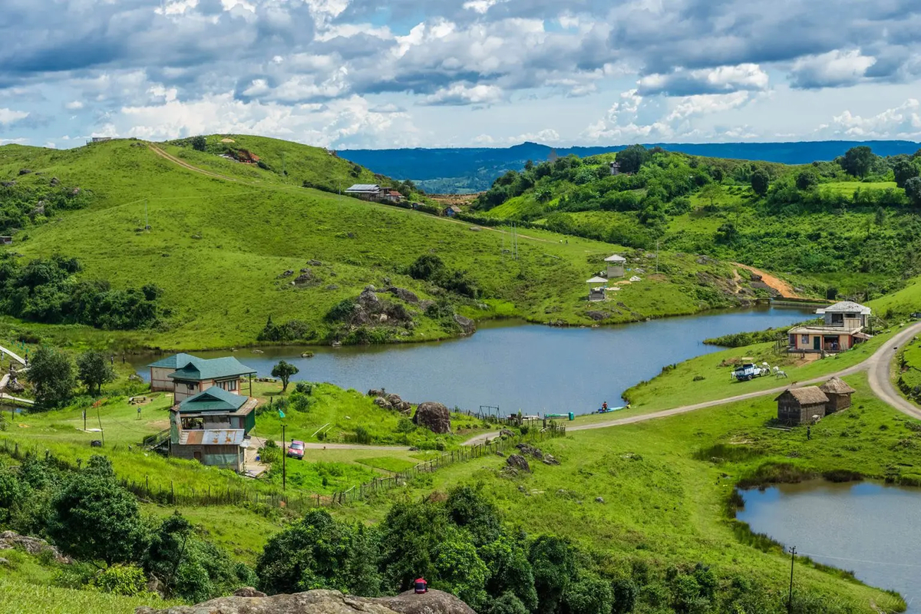
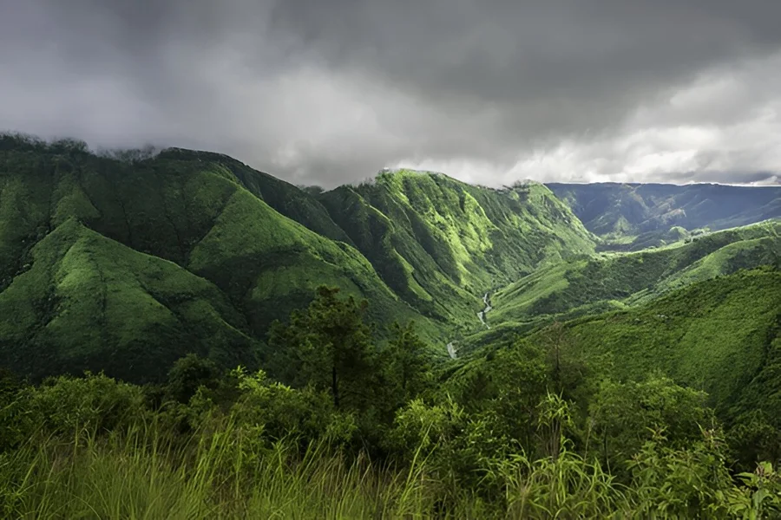
Creation of Meghalaya (1972)
Demand raised by:
  Khasi
  Jaintia
  Garo communities.
Movement led by Williamson A. Sangma.
Key stages:
  Autonomous State within Assam (1970)
  Full statehood in 1972
Thus Meghalaya became a separate state.

Slide 21
Creation of Manipur and Tripura (1972)
Both were earlier Union Territories.
In 1972, they became full states:
  Manipur
  Tripura
Reasons:
  Democratic aspirations
  Administrative needs
  Cultural identity.

Slide 22
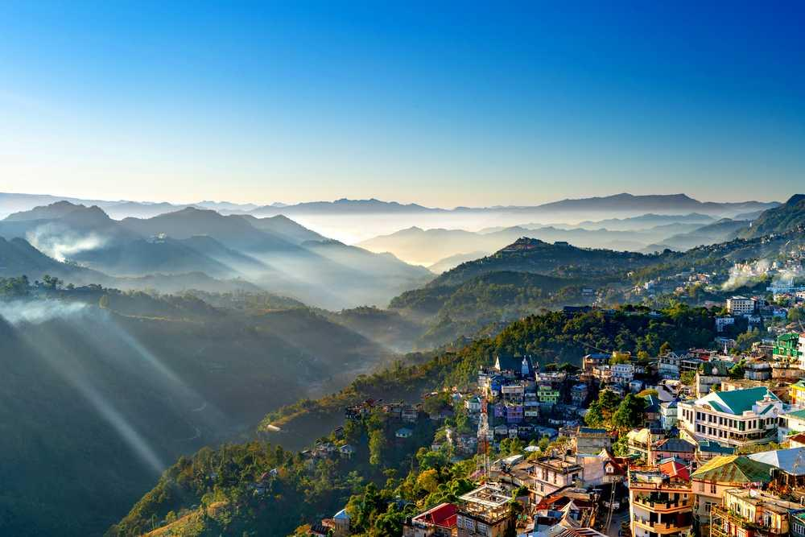
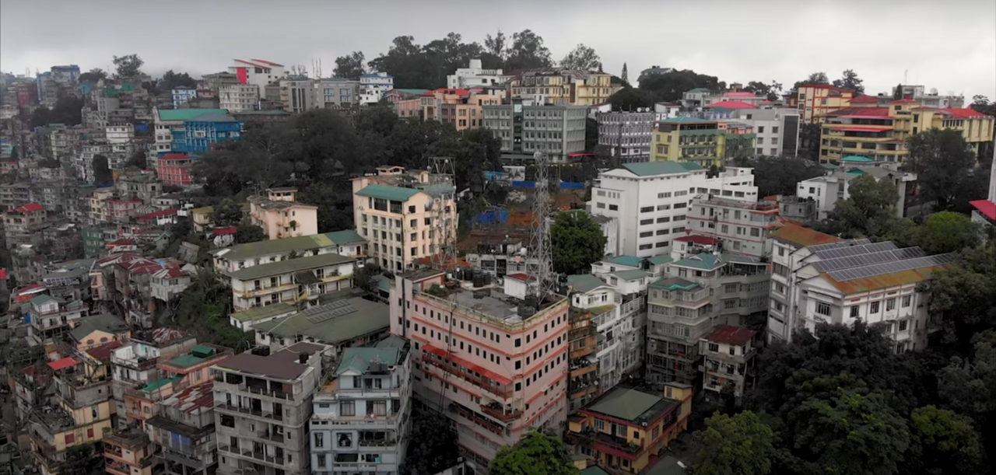
Creation of Mizoram (1987)
The Mizo National Front (MNF) insurgency demanded independence.
Important event:
  Mizoram Peace Accord
Signed between:
  Government of India
  Mizo National Front
Outcome:
  Mizoram became a state in 1987.

Slide 23
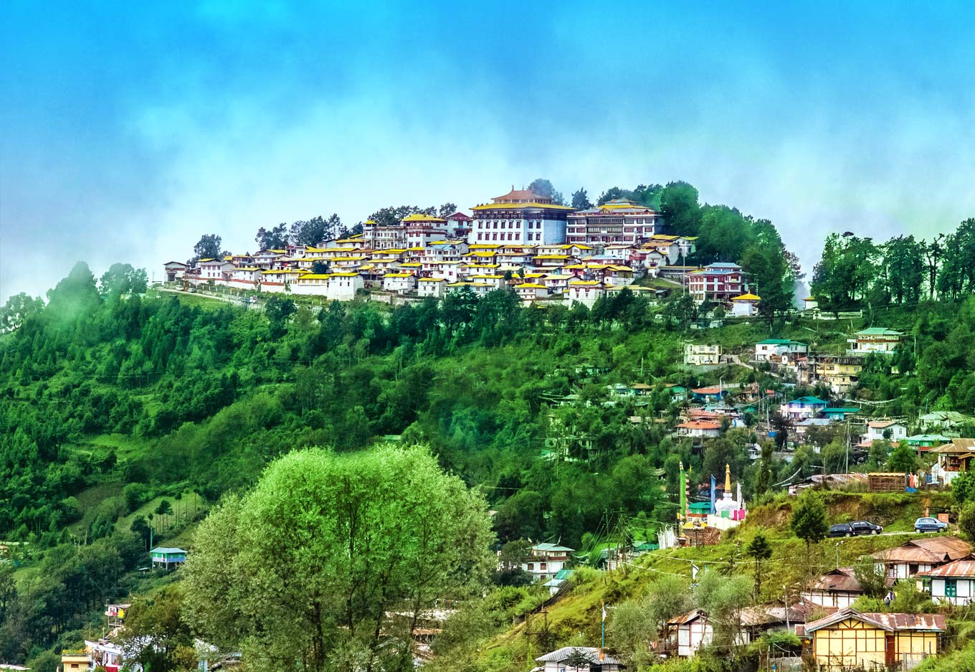
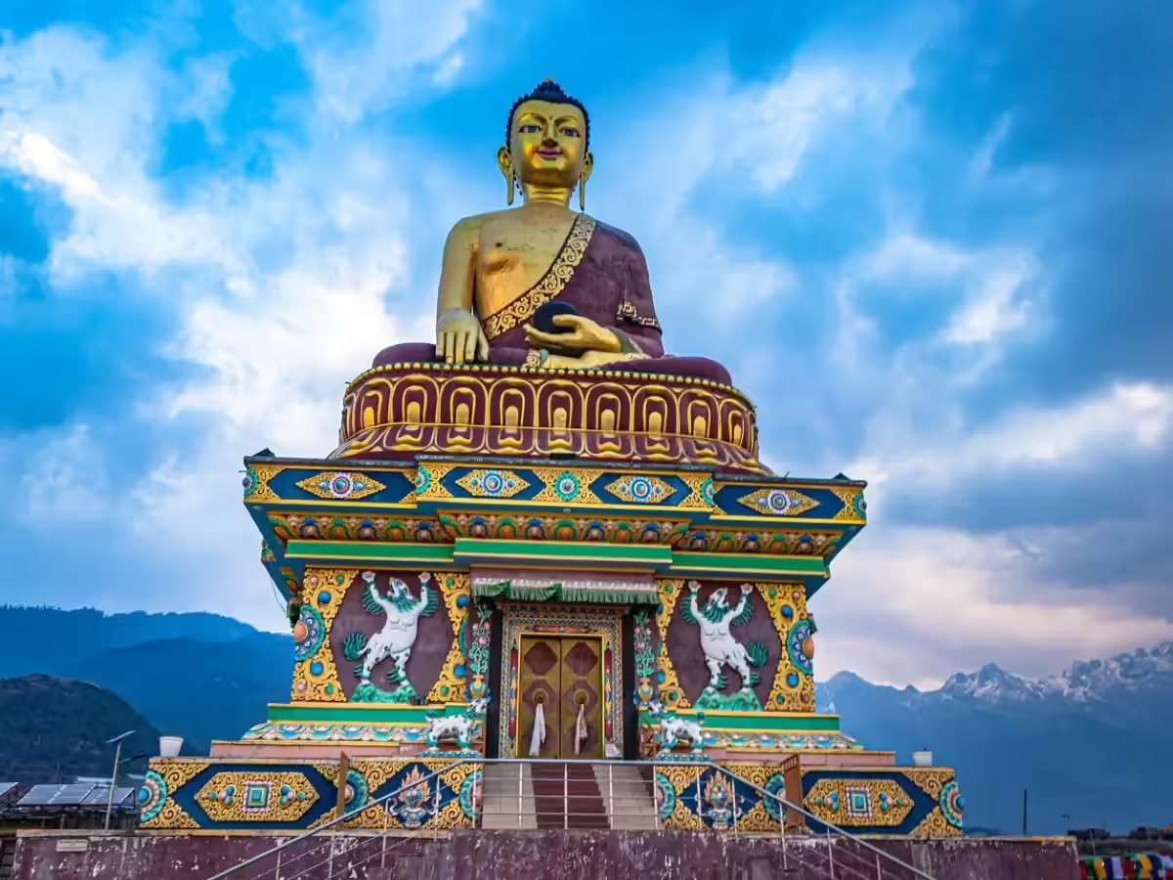
Creation of Arunachal Pradesh (1987)
Earlier known as North East Frontier Agency (NEFA).
Key developments:
  Became Union Territory in 1972.
  Became full state in 1987.
Today it is known as Arunachal Pradesh.

Slide 24
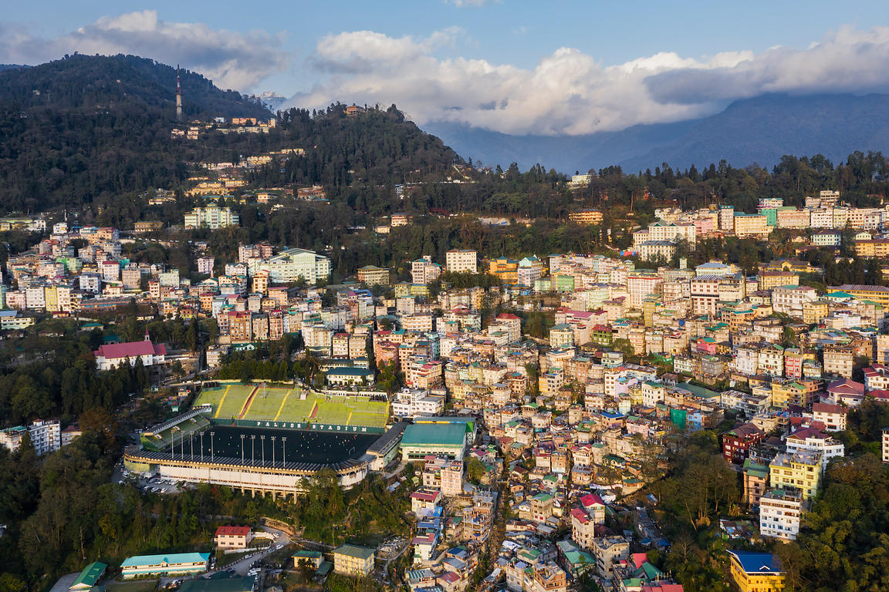
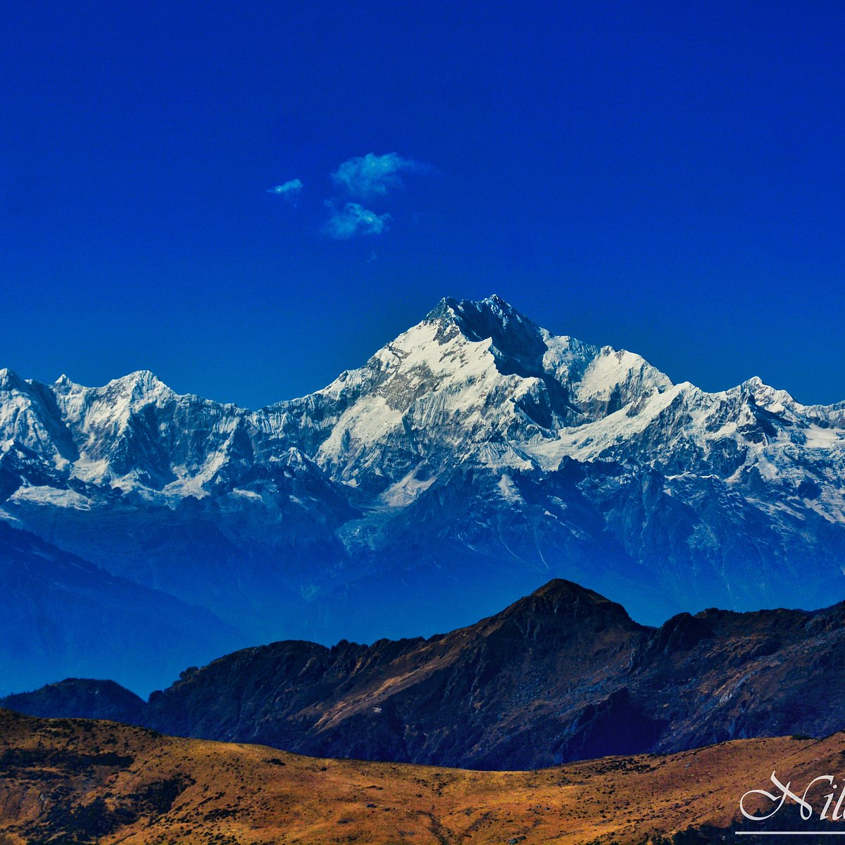
Inclusion of Sikkim (1975)
Earlier an independent kingdom ruled by the Chogyal.
After political changes:
  Referendum held in 1975.
  Sikkim joined India.
Thus Sikkim became the 22nd state of India.

Slide 25
Major Reasons for Reorganisation
Ethnic identity movements
Demand for self-governance
Cultural protection
Administrative efficiency
Insurgency and conflict resolution

Slide 26
Impact of Reorganisation
Positive impacts:
  Recognition of ethnic identities
  Greater political representation
  Regional development
  Improved governance.
However challenges remain:
  Ethnic conflicts
  Insurgency
  Border disputes
  Development gaps.

Slide 27
Continuing Issues in Northeast India
Key challenges:
  Ethnic tensions
  Autonomy demands
  Migration issues
  Development disparities
Example:
  Autonomous movements in Assam and Manipur.

Slide 28
Conclusion
The reorganisation of Northeast India was a complex political process aimed at:
  Managing ethnic diversity
  Promoting regional stability
  Integrating the region with India.
Despite challenges, it remains a significant example of federal flexibility in India.

Slide 29


