Slide 1

POL040204: Political Theory: Concepts and Debates
Aniruddha Kumar Baro

Slide 2
POL040204: Political Theory: Concepts and Debates
Unit-I: Freedom and Equality
Freedom: Lockean notion of Negative Freedom & Amartya Sen’s notion of Development as Freedom
Equality: Procedural Equality and Substantive Equality
Egalitarianism: Background inequalities and differential treatment
Unit-II: Justice
Distributive Justice: John Rawls
Libertarian theories of Justice: F. A. Hayek
Global Justice

Slide 3
Unit-III: Rights and Obligation
The Universality of Rights and Differentiated Rights
Rights, Obligation and Civil Disobedience
Theories of Political Obligation: Conservatism, Consent Theory, Anarchism
Unit-IV: Major Debates
Whatever happens to nation-state? Sovereignty under Globalization.
How do we accommodate diversity in plural society? Diversity and Multiculturalism.
How do we deal with the climate changes? Ecological Rights as human rights

Slide 4
Unit-II: Justice
Distributive Justice: John Rawls
Libertarian theories of Justice: F. A. Hayek
Global Justice

Slide 5
Distributive Justice: John Rawls

Slide 6
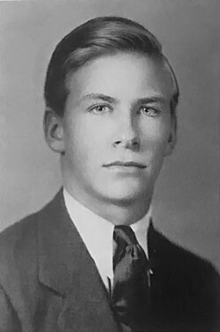
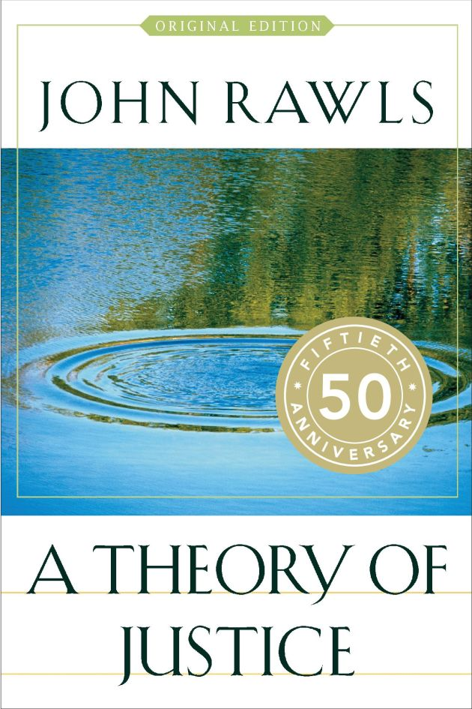
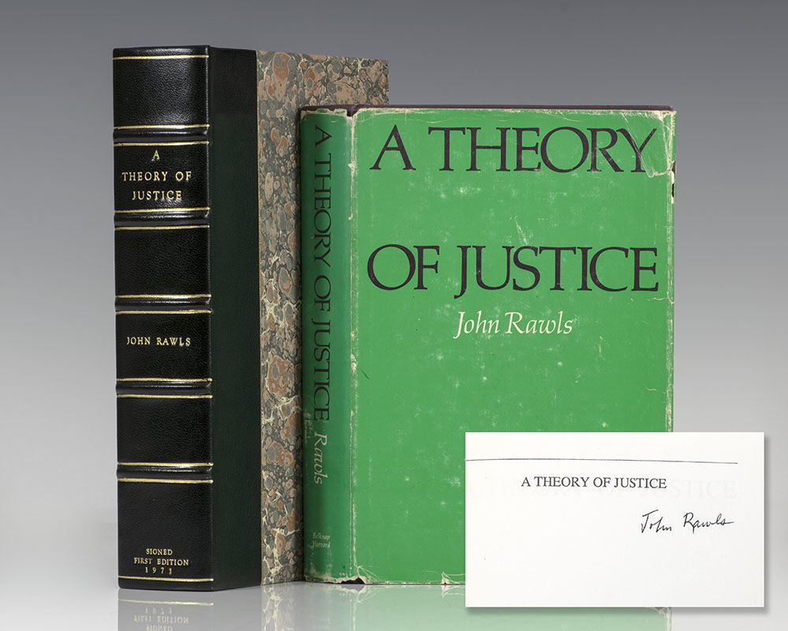

Slide 7
What is Distributive Justice?
Meaning
Distributive justice concerns:
How benefits and burdens of society should be distributed
Distribution of:
Income
Wealth
Opportunities
Rights
Offices
Core Question:
👉 Who should get what, and why?
Philosophical Background:
Aristotle – Proportionate equality
Karl Marx – From each according to ability…
Robert Nozick – Entitlement theory

Slide 8
Historical Context of Rawls
20th Century Context
World War II
Rise of Welfare State
Cold War: Capitalism vs Socialism
Civil Rights Movement (USA)
Major Work:
📘 A Theory of Justice (1971)
Rawls tried to:
Reconcile liberty and equality
Offer an alternative to utilitarianism

Slide 9
Rawls Against Utilitarianism
Utilitarianism:
Jeremy Bentham
John Stuart Mill
"Greatest happiness of the greatest number“
Rawls’ Criticism:
Sacrifices minority rights
Allows inequality if majority benefits
Ignores fairness
💡 Rawls says: Justice must protect the least advantaged.

Slide 10
Justice as Fairness
Rawls’ theory = Justice as Fairness
Two key ideas:
Original Position
Veil of Ignorance
Justice = What rational people would choose under fair conditions.

Slide 11
The Original Position
Imagine:
People choosing principles of justice
Before entering society
Without knowing their status
It is a hypothetical social contract situation.
Inspired by:
Thomas Hobbes
John Locke
Jean-Jacques Rousseau

Slide 12
Veil of Ignorance
Core Idea
You do NOT know:
Your caste
Your religion
Your gender
Your class
Your talents
Your social status
Question:
👉 What kind of society would you choose?

Slide 13
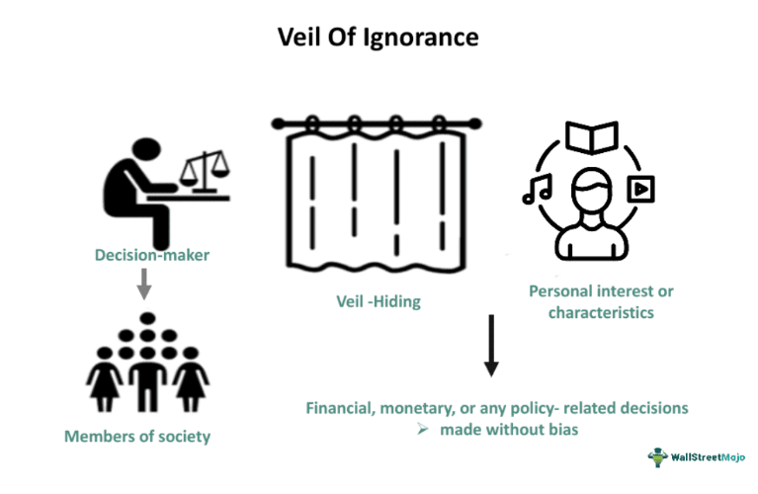
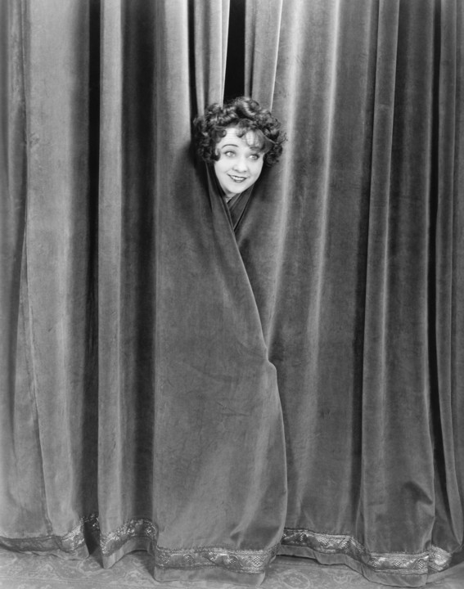


Slide 14
Why Veil of Ignorance?
Because:
It ensures impartiality
Removes bias
Promotes fairness
People will choose:
Safe principles
Protection for worst-off
Equal rights
Rawls calls this the Maximin Rule
(Maximize the minimum position)

Slide 15
Two Principles of Justice
Rawls proposes TWO principles:
1️⃣ First Principle (Liberty Principle)
Equal basic liberties for all.
2️⃣ Second Principle
Social & economic inequalities are justified only if:
They benefit the least advantaged
Offices are open to all (fair equality of opportunity)

Slide 16
First Principle – Equal Liberty
Includes:
Freedom of speech
Freedom of religion
Political participation
Right to vote
Rule of law
Similar to:
Indian Constitution: Articles 14–19
Fundamental Rights

Slide 17
Second Principle Explained
Two parts:
(a) Fair Equality of Opportunity
Not just formal equality
But real access (education, health)
(b) Difference Principle
Inequality is allowed only if it benefits the poorest.
Example:
If a doctor earns more,
Society benefits only if:
Medical services improve
Poor get better healthcare

Slide 18
The Difference Principle (Deep Understanding)
It does NOT demand complete equality.
It says:
Inequality is acceptable if:
👉 It improves the condition of the least advantaged.
Example:
Reservation policy in India
Welfare schemes
MNREGA

Slide 19
Rawls and Indian Context
Application in India:
Reservation Policy
Right to Education
Welfare schemes
SC/ST Act
Affirmative action
Link with:
Social justice
Constitutional morality

Slide 20
Basic Structure of Society
Rawls focuses on:
The Basic Structure of society:
Constitution
Economic system
Legal system
Political institutions
Justice must regulate institutions, not individual morality.
Primary Goods
Rawls says people want:
Rights
Liberties
Income
Wealth
Opportunities
Self-respect
These are called Primary Goods.

Slide 21
Criticism of Rawls
1️⃣ Libertarian Critique – Robert Nozick
Redistribution violates property rights.
2️⃣ Communitarian Critique – Michael Sandel
Too individualistic
Ignores community values
3️⃣ Marxist Critique
Does not abolish capitalism
Accepts inequality

Slide 22
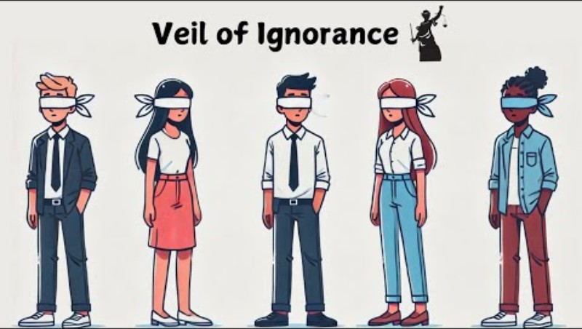
Video

Slide 23
Rawls vs Nozick (Comparison Table)
Rawls
Nozick
Justice as fairness
Redistribution allowed
Focus on equality
Protect least advantaged
Entitlement theory
No redistribution
Focus on liberty
Protect property rights

Slide 24


