Slide 1
Subject: Economics
Class: - FYUGP 2nd Semester
Paper: Essentials of Economics
Topic: Financial System
By
Dr. Binita Tamuli Barman

Slide 2
Financial System
A financial system is a set of institutions, such as banks, insurance companies, and stock exchanges, that permit the exchange of funds. Financial systems exist on firm, regional, and global levels.
Borrowers, lenders, and investors exchange current funds to finance projects, either for consumption or productive investments, and to pursue a return on their financial assets.
The financial system also includes sets of rules and practices that borrowers and lenders use to decide which projects get financed, who finances projects, and terms of financial deals.

Slide 3
Formal and Informal Financial System:
A formal financial system refers to the organized, regulated, and institutionalized framework within a country's economy that facilitates financial transactions and intermediation.
It comprises institutions such as banks, insurance companies, stock exchanges, and regulatory bodies like central banks and securities commissions.
. The informal financial system, also known as the informal economy or shadow banking system, exists alongside the formal financial system and encompasses various unregulated or loosely regulated financial activities and transactions.
It includes informal savings and credit associations, moneylenders, pawnshops, and other non-traditional financial intermediaries operating outside the mainstream banking sector.

Slide 4
Formal and Informal Financial System
3. These institutions operate under specific legal and regulatory frameworks, ensuring transparency, stability, and accountability in financial activities.
4. The formal financial system plays a crucial role in mobilizing savings, allocating capital, facilitating investment, and managing risks within an economy
3. Participants in the informal financial system often lack access to formal financial services due to factors such as limited income, lack of documentation, or distrust in formal institutions
4. Informal financial systems can provide essential financial services to marginalized populations, they may also be associated with higher risks, lack of consumer protection, and vulnerability to exploitation.

Slide 5
Components of Financial System
Financial institution
The entities that provide financial services, such as banks, credit unions, insurance companies, investment banks, and pension funds, are called financial institutions. They act as intermediaries between savers and borrowers, channeling funds from savers to borrowers.
2. Financial markets
Financial markets are platforms where individuals, businesses, and governments buy and sell financial assets. Here are the various types of financial markets:
Stock markets (for trading shares of companies), bond markets (for trading debt securities)
Commodity markets (for trading commodities like gold, oil, etc.)
Foreign exchange markets (for trading currencies)

Slide 6
Components of Financial System
3. Financial instruments
Financial instruments are monetary contracts that can be traded. Financial instruments include stocks, bonds, options, futures contracts, mortgages, and derivatives. Financial instruments provide a means for investors to invest their funds and for borrowers to raise capital.
4. Financial services: Another significant component of the financial system is financial services. Financial services refer to the range of services provided by financial institutions to support financial activities.

Slide 7
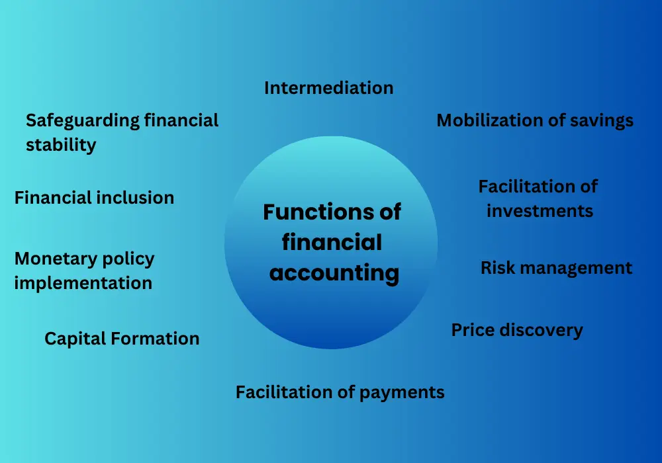
Functions of the financial system

Slide 8
Functions of the financial system
1. Intermediation
Financial systems act as intermediaries between savers and borrowers, channeling funds from those who have excess funds (savers) to those who need funds (borrowers). This intermediation process facilitates the efficient allocation of capital and promotes economic growth.
2. Mobilization of savings
Financial systems provide a mechanism for individuals and businesses to save money and earn a return on their savings. Through banks, investment funds, and other financial institutions, savings are pooled together and made available for productive investments.

Slide 9
3. Facilitation of investments
Financial systems enable individuals, businesses, and governments to access the capital needed for investment in productive activities. They provide various investment options such as stocks, bonds, and venture capital, allowing entities to raise funds to expand operations, launch new projects, or develop infrastructure
4. Risk management
Financial systems offer a range of risk management tools and instruments, such as insurance, derivatives, and hedging strategies. These mechanisms help individuals and businesses mitigate risks associated with fluctuations in interest rates, exchange rates, commodity prices, and other market uncertainties.

Slide 10
Functions of the financial system
6. Facilitation of payments
Financial systems enable the smooth and secure transfer of funds between individuals, businesses, and institutions. They provide payment systems, such as electronic funds transfer, credit cards, and digital wallets, which facilitate the settlement of transactions and support economic activities.
7. Capital Formation
Financial systems play a crucial role in capital accumulation within an economy. By mobilizing savings, facilitating investments, and promoting efficient allocation of capital, they contribute to capital stock growth, which is essential for long-term economic development.
8. Monetary policy implementation
Central banks implement monetary policy as part of the financial system by controlling the economy’s money supply, interest rates, and liquidity. They regulate and stabilize the financial system, ensuring price stability and fostering macroeconomic stability.

Slide 11
Functions of the financial system
9. Financial inclusion
Financial systems aim to promote financial inclusion by providing access to financial services for individuals and businesses, including those in underserved or marginalized communities. This fosters economic participation, poverty reduction, and social development.
10. Safeguarding financial stability
The financial system maintains stability and mitigates systemic risks. Regulatory authorities monitor and supervise financial institutions, set prudential standards, and establish risk management frameworks to safeguard the system’s stability and protect consumers.

Slide 12
Thank You

